Slide 1

UNITED NATIONS GLOBAL GEODETIC
CENTRE OF EXCELLENCE
MODERNISING GEOSPATIAL REFERENCE SYSTEM
CAPACITY DEVELOPMENT WORKSHOP
Introducing regional collaboration in geodesy
Nicholas Brown
Head of Office, UN-GGCE
Day 1, Session 3 [1_3_3]
WHO
Acknowledgements: Abdullah AlQahtani (KSA); Zuheir Altamimi (FRA); Fernand Bale (CIV); Detlef Angerman (TUM); Johannes Bouman (GER); Dana J Caccamise II (USA); Sergio Cimbaro (ARG); Gustavo Caubarrere (URY); Andrick Lal (SPC); Anna Riddell (AUS); Daniel Roman (USA); Jeffrey Verbeurgt (BEL).

Slide 2
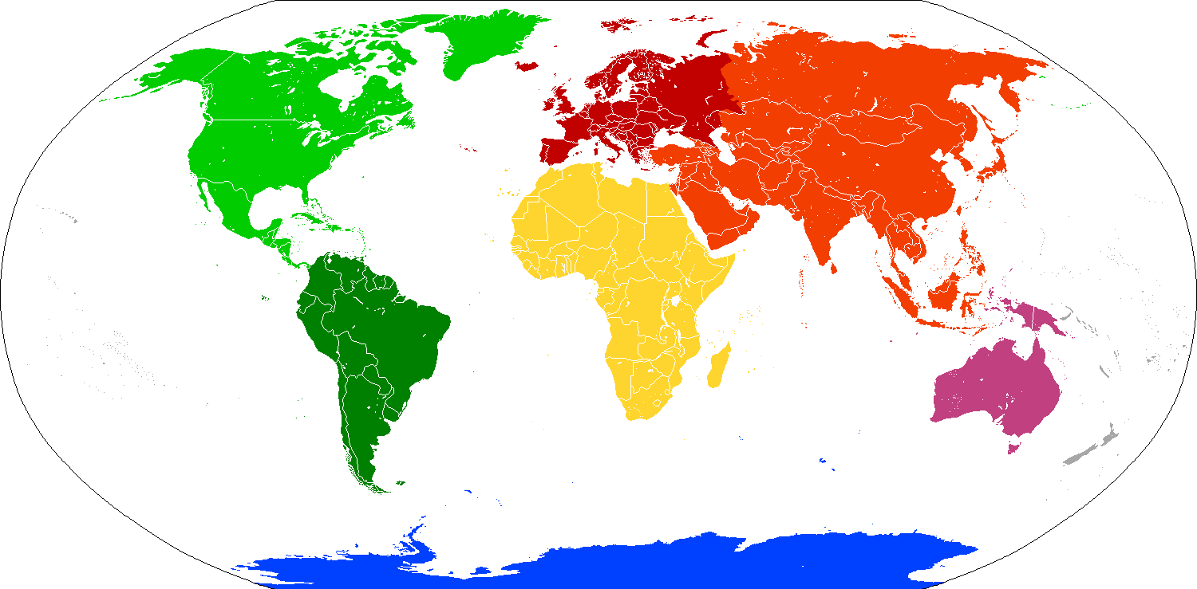
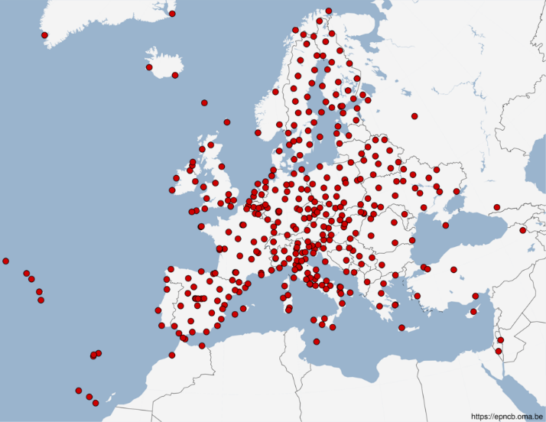

Motivation for regional collaboration
Continental densification of the International Terrestrial Reference frame (ITRF)
  The realization of ITRF has to restrict the number of GNSS sites for computational reasons
  The purpose of ITRF is to determine an accurate global model (not monitor geophysical processes)
The basis for national geodetic datum development
More detailed monitoring of continental stability
Geo-referencing and positioning applications, e.g cadaster, land administration, …
Basis for monitoring of regional deformations
Unification of geodetic and mapping applications within a continent or a region
STRONGER.
TOGETHER.

Slide 3
Benefits of a regional reference frame?
Benefits of a regional reference frame
Learning and working together to:
  accurately analyze GNSS data
  determine geodetic parameters
  use GNSS data for scientific and societal applications
Need cooperation: data, analysis & combination centers
Need data sharing between countries
Leads to densification of ground stations
Improved access to the ITRF using IGS products

Slide 4
From ITRF to Regional Reference Frames (2/3)
Ways to create a regional reference frame
European Terrestrial Reference System 1989 (ETRS89)
Regional realization of the ITRF fixed to the Eurasian plate at epoch 1989.0.
ETRS89 is static
Since the Eurasian plate moves at an approximate rate of 2.5 cm per year relative to the ITRF, the difference between the ITRF and ETRS89 increases with time. To handle this, a time-dependent transformation is applied:
  GNSS-derived coordinates are calculated in the ITRF for the observation epoch (e.g., 2025.0). These coordinates are then transformed back to the ETRS (as referenced to 1989.0 (or an epoch of their choosing)) using plate motion models and transformations (e.g. NNR-NUVEL-1A or more recent versions (e.g., ITRF2014 Plate Motion Model or ITRF2020 Plate Motion Model).
Coordinate velocities are “minimized" instead of “eliminated“. While continental drift is largely mitigated, there are residual effects that cannot be entirely removed:
  Local Tectonic Deformation: Regions within Europe that experience seismic activity or crustal deformation (e.g., near plate boundaries or fault zones) may still see small positional changes over time.
  Plate Flexing: Even within the "stable" part of the Eurasian plate, minor deformations can occur, causing slight deviations in position over long periods.
Updates to ETRS89 (e.g., ETRF2000, ETRF2014) are released periodically to reflect advancements in geodesy but maintain the static plate-fixed assumption.
Uses fixed transformations to align GNSS-derived coordinates (in ITRF) with the static Eurasian plate framework.

Slide 5
From ITRF to Regional Reference Frames (2/3)
Ways to create a regional reference frame
 | Europe | Asia-Pacific | Americas
Static / Time Dependent | Static | Time Dependent | Time Dependent
Epoch | 1989 | Middle of each week | Middle of each week

Slide 6
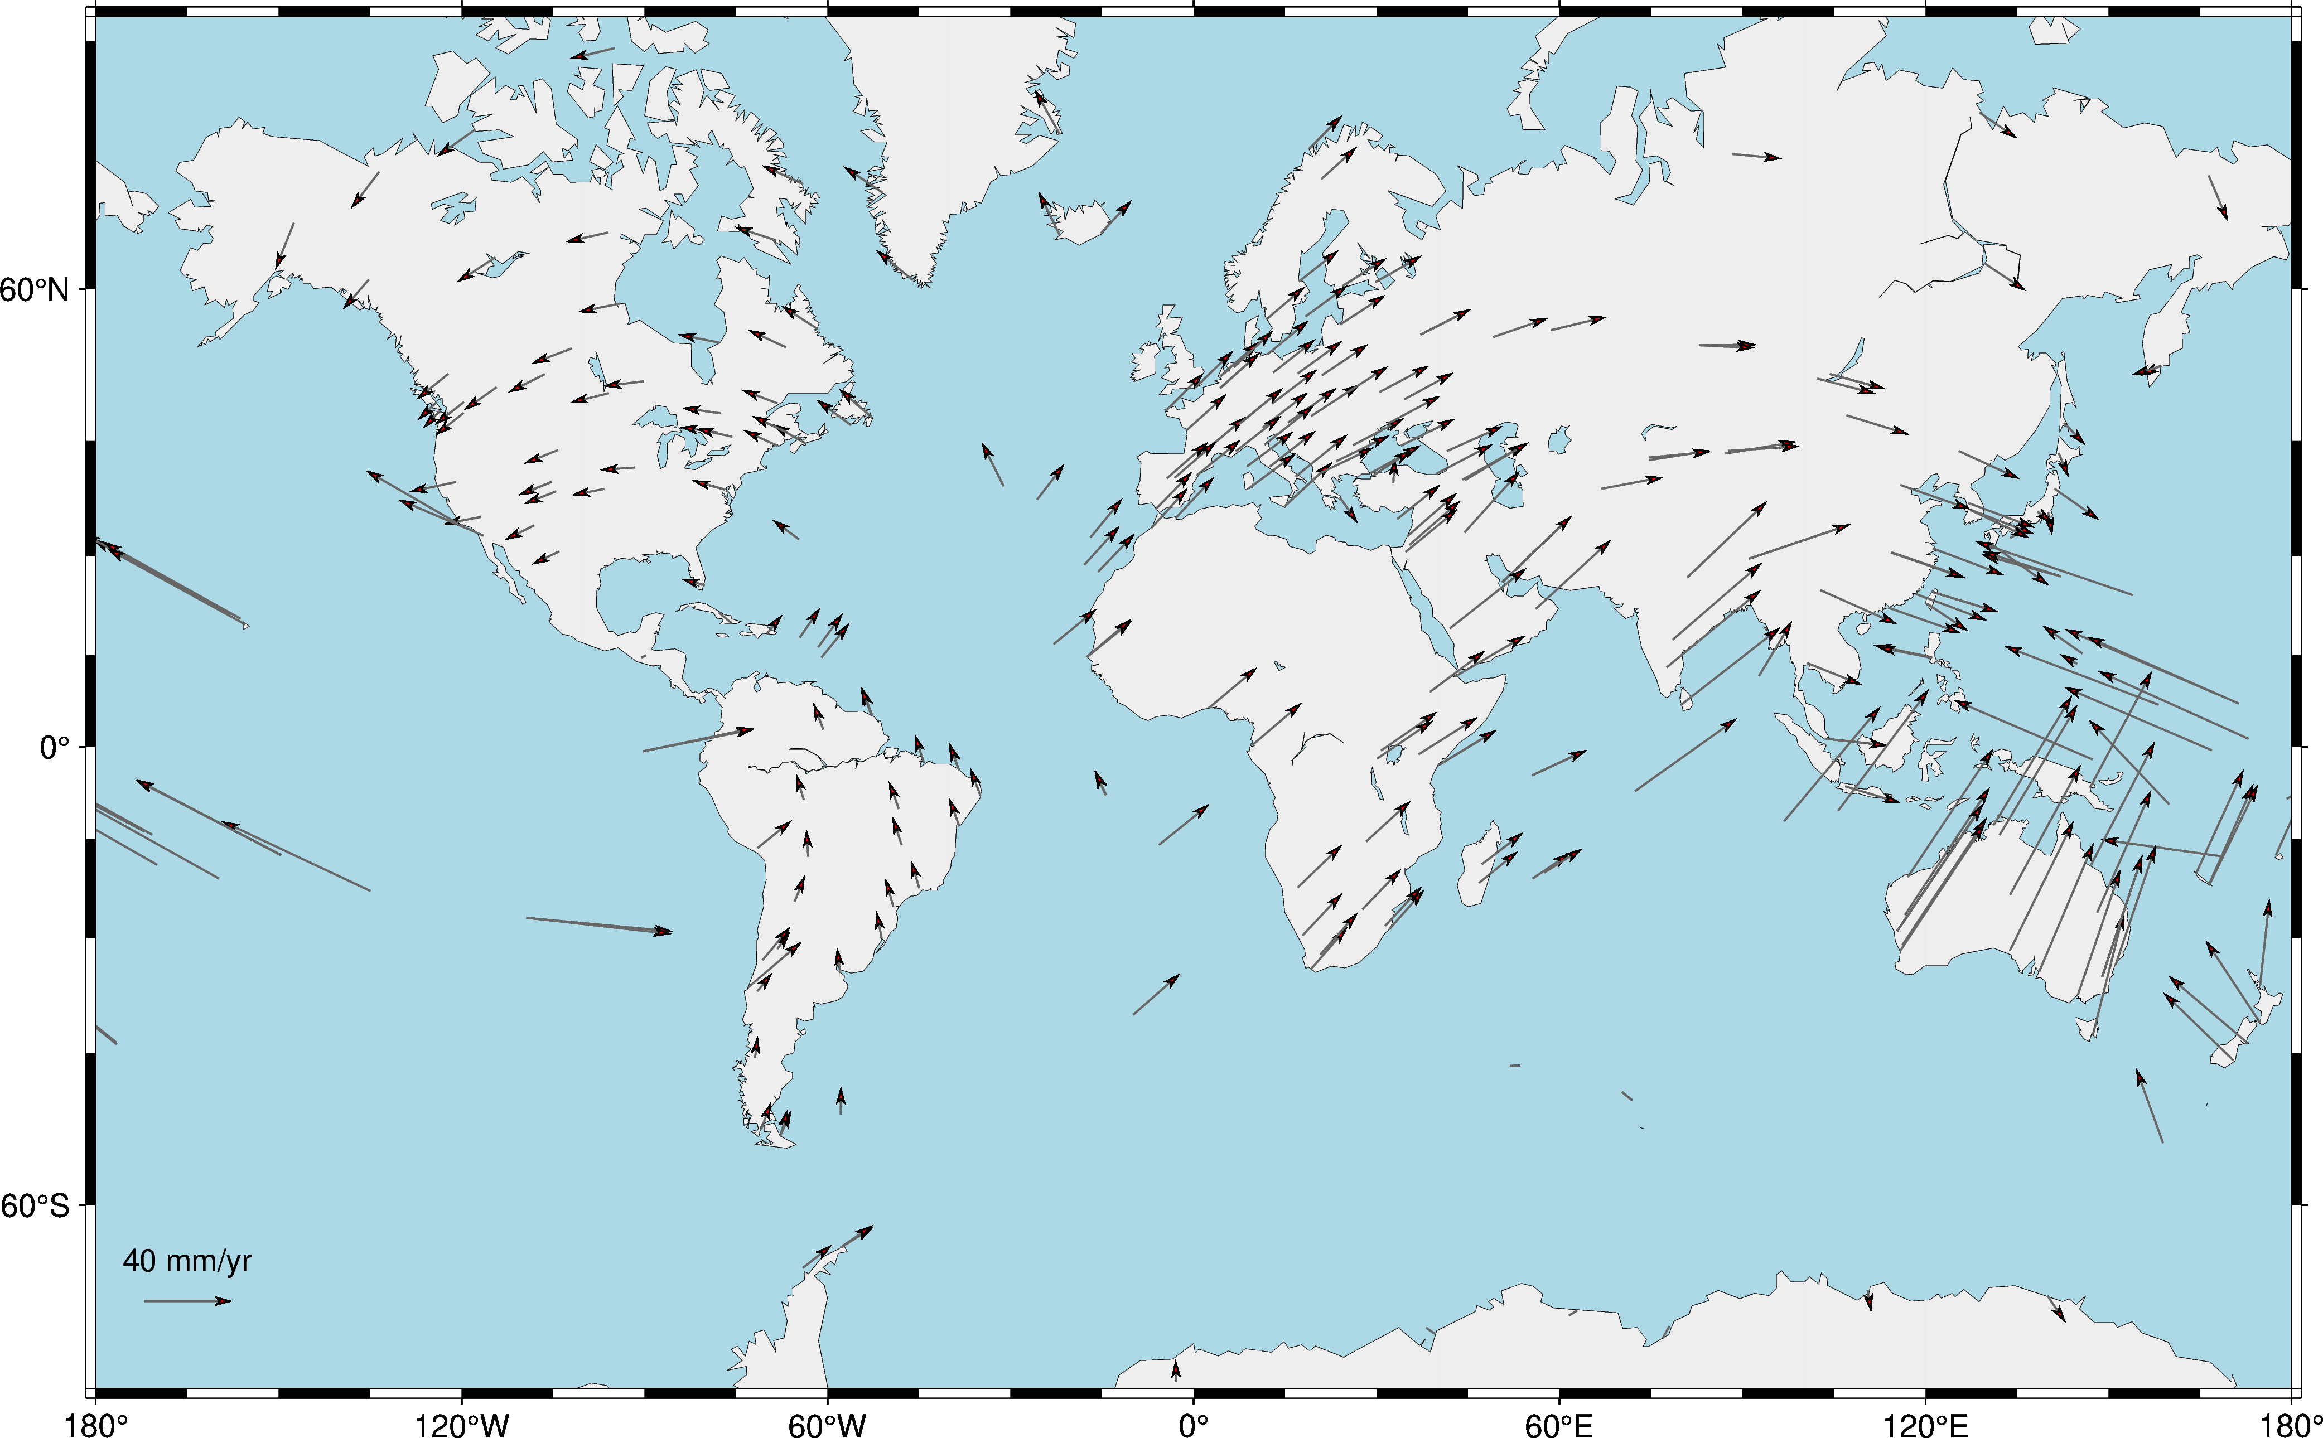
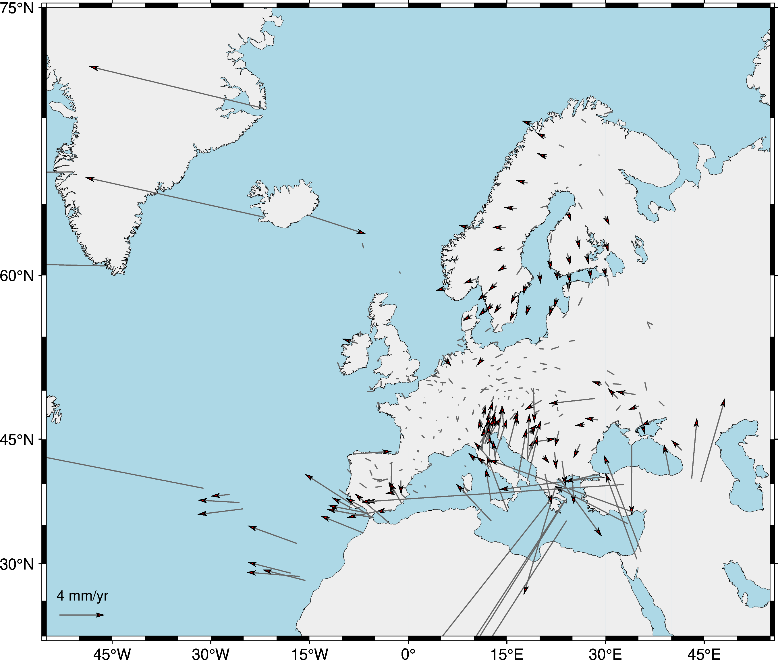
From ITRF to Regional Reference Frames (2/3)
Ways to create a regional reference frame
European Terrestrial Reference System 1989 (ETRS89) – “minimizing the residuals”

Slide 7
From ITRF to Regional Reference Frames (2/3)
Ways to create a regional reference frame
Asia-Pacific Reference Frame (APREF)
Regional realization of the ITRF not a single tectonic plate but is instead a direct realization of the ITRF for the Asia-Pacific region.
APREF is a time dependent reference frame
APREF Central Bureau provides updated coordinates weekly to reflect tectonic plate motions, seismic shifts, and other geodynamic processes.
Some national geodetic datums use the time dependent APREF as constraint for national static datums (e.g. Australia and New Zealand)
Australia uses a plate motion model based on APREF data to propagate coordinates between the national static datum (fixed to 2020) and ITRF
New Zealand uses a deformation model based on APREF data (and local data pre and post earthquakes) to propagate coordinates between the national static datum (2000) and ITRF.
The regional time dependent reference frame supports applications in the Asia-Pacific region, where plate motion and seismic activity are significant (e.g. earthquake monitoring, tsunami warning systems, and high-precision navigation)
While both ETRS89 and APREF serve as regional geodetic reference frameworks, their operation and design reflect their respective tectonic environments. The ETRS is static, tied to the Eurasian plate, and suited for Europe's relatively stable context. The APREF, on the other hand, operates dynamically in direct alignment with the ITRF, reflecting the tectonic activity and complexity of the Asia-Pacific region.

Slide 8
ITRF and regional networks
International Association of Geodesy
(IAG)
Operation of ITRF
EUREF
NAREF
IAG Commission 1
Reference Frames
AFREF
APREF
SIRGAS
Sub-commission 1.3
Regional Reference Frames
SCAR
EUREF
1.3a
Europe
SIRGAS
1.3b
South America
NAREF
1.3c
North America
AFREF
1.3d
Africa
APREF
1.3e
Asia Pacific
SCAR
1.3f
Antarctic

Slide 9
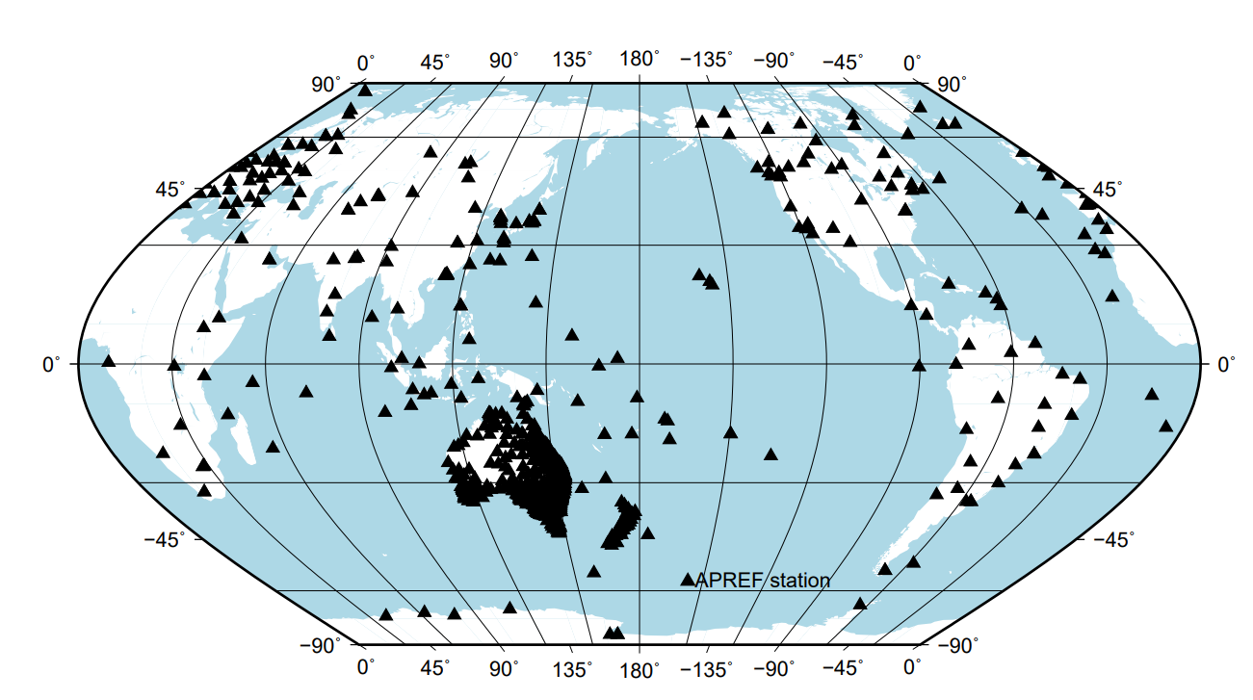
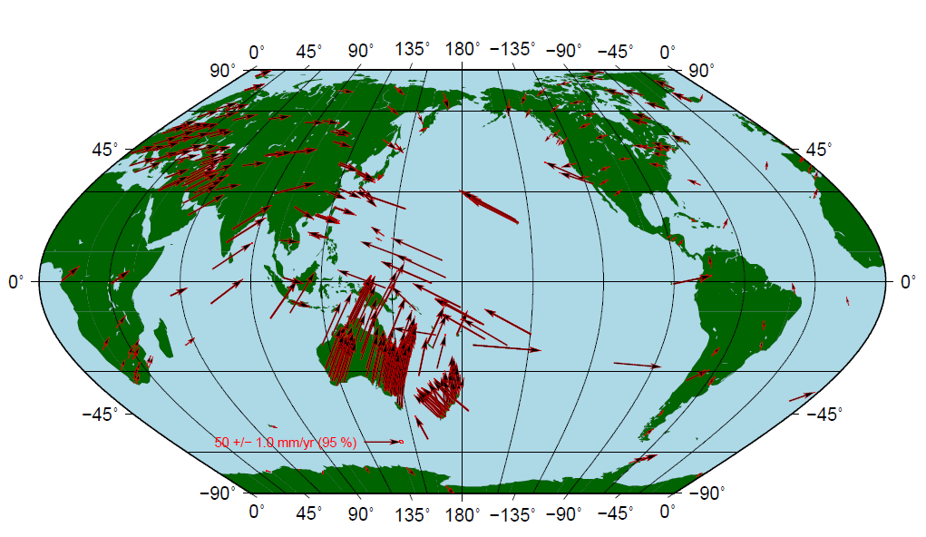
APREF (Asia Pacific Reference Frame)
Densification in Asia-Pacific region
Total 1053 CORS (2023)
Including 332 IGS20 CORS
Three regional GNSS analysis centres
Geoscience Australia develops a combined solution from the analysis centres
Central Bureau in Geoscience Australia

Slide 10

European reference Frame - EUREF
EUREF
About 450 stations
16 Analysis centers
ETRS 89 – European Terrestrial Reference System
Coincides with ITRF at epoch 1989.0
Tied to continental plate
Basis for precise GNSS in Europe
Different national realizations based on ITRS89
Example Realization Germany: ITRS89/DREF91

Slide 11
SIRGAS
SIRGAS: Sistema de Referencia Geodésico para las Américas
  In English: Geodetic Reference System for the Americas
  SIRGAS has roots in both the International Association of Geodesy (IAG) and the Pan American Institute of Geography and History (PAIGH)
    SIRGAS is IAG 1.3b but is separately an NGO for the Americas
  Three WG’s inside SIRGAS
    WG1 – Reference System: combines IAG 1.3b, 1.3c (SIRGAS and NAREF)
    WG2 - SIRGAS at national level: National implementation of SIRGAS
    WG3 – Vertical Datum: combines IAG 2.4b and 2.4c (GG in SA and GG NCA)
Notes:
Speaker: Gustavo
Talking Points: Note that the GRFA members are intended to be identical to the SIRGAS Directing Council
Cover the internal organization of SIRGAS

Slide 12
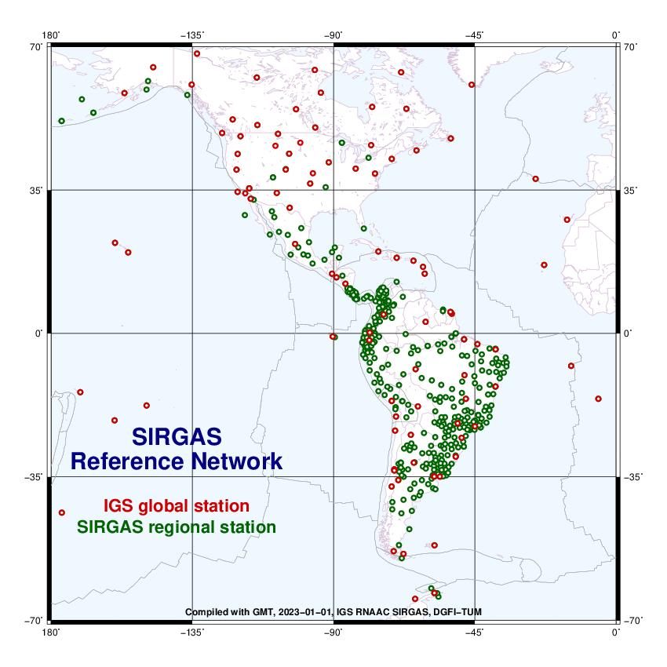
SIRGAS
About 500 stations
Regional Analysis Center of Associates of the IGS Network for SIRGAS (IGS, RNAAC, & SIRGAS)
11 SIRGAS Processing Centres (Local) in the Americas Nations
Two SIRGAS Combination Centres
VLBI Analysis Center of IVS
SLR processing Center in progress
SIRGAS-N - National reference network.
Improves the densification of the core network
Provides national and local access to the reference frame
Both, SIRGAS-C and SIRGAS-N satisfy the same characteristics and quality
Each station is processed by three analysis centres.

Slide 13
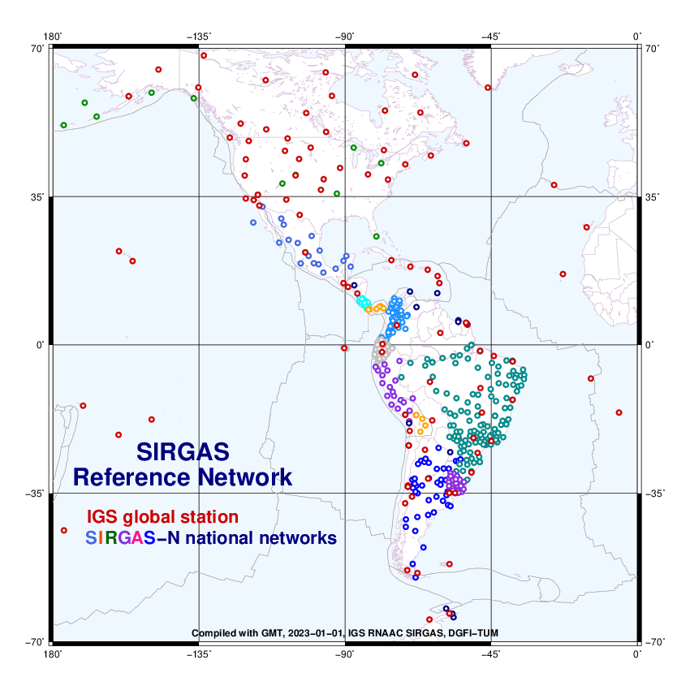
SIRGAS
Almost all countries in the Americas are aligned with ITRF.
They are working to incorporate all countries, particularly those in the Caribbean.
Notes:
Speaker - Gustavo
Talking Points: Still working to include more Nations particularly from the Caribbean
WG2 works with members to align their national systems to SIRGAS
These national densifications fit the respective national datums but can be related back to SIRGAS and the ITRS

Slide 14
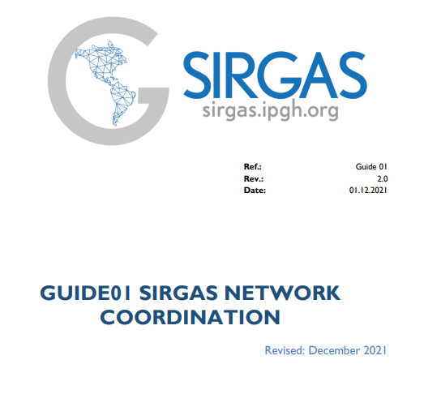
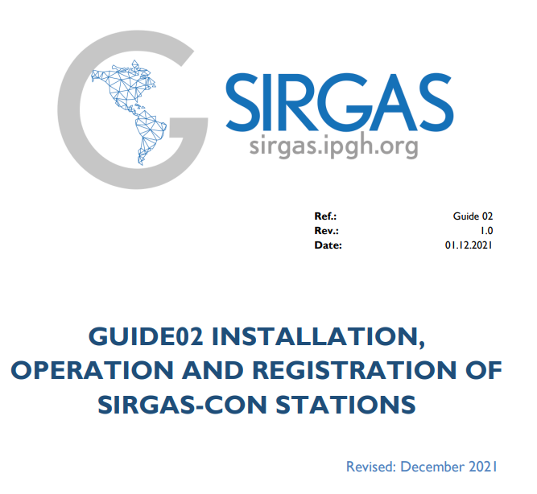
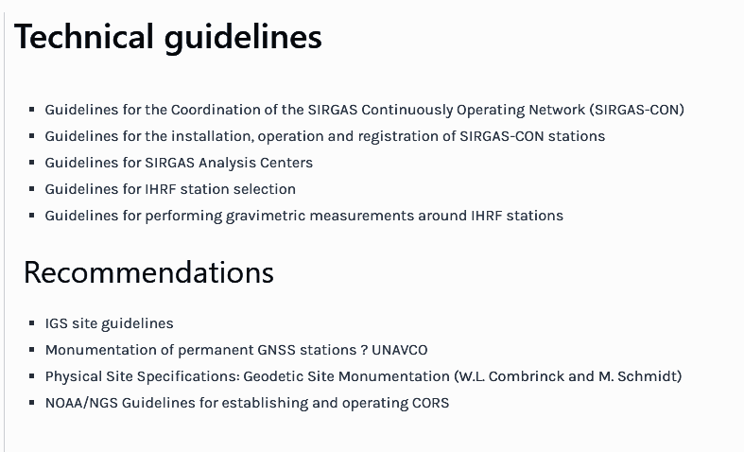
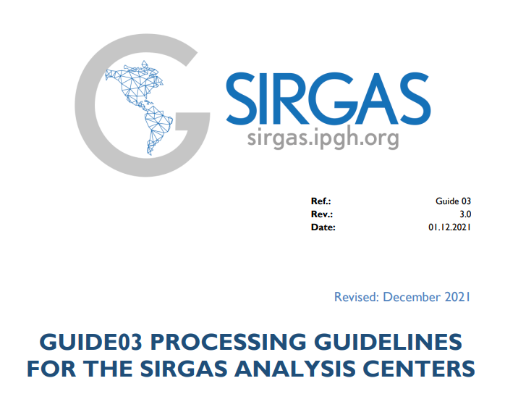
SIRGAS
Notes:
Speaker - Gustavo
Talking Points: WG 2 has documented guidance to aide new accessions into SIRGAS

Slide 15
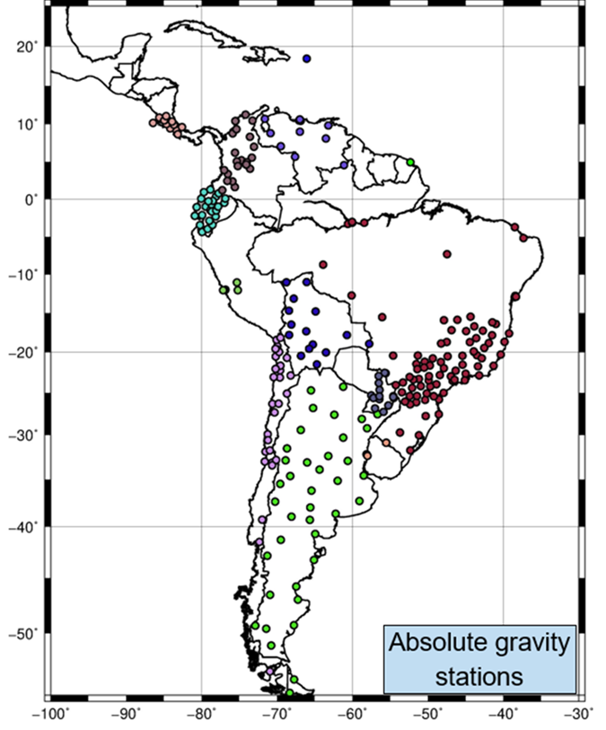
IAG 2.4b
SIRGAS
SIRGAS works together with universities and geographic institutes to determine absolute gravity stations in the region.
SIRGAS encourages countries to keep data open and share gravity information in the AGrav (Absolute Gravity Database) repository of the International Gravity Field Service (IGFS) (agrav.bkg.bund.de).
Notes:
Speaker - Dan
Talking Points: Absolute gravity stations provide the unification for relative gravity throughout the Americas
We also aim to support making all data available following F.A.I.R principals

Slide 16
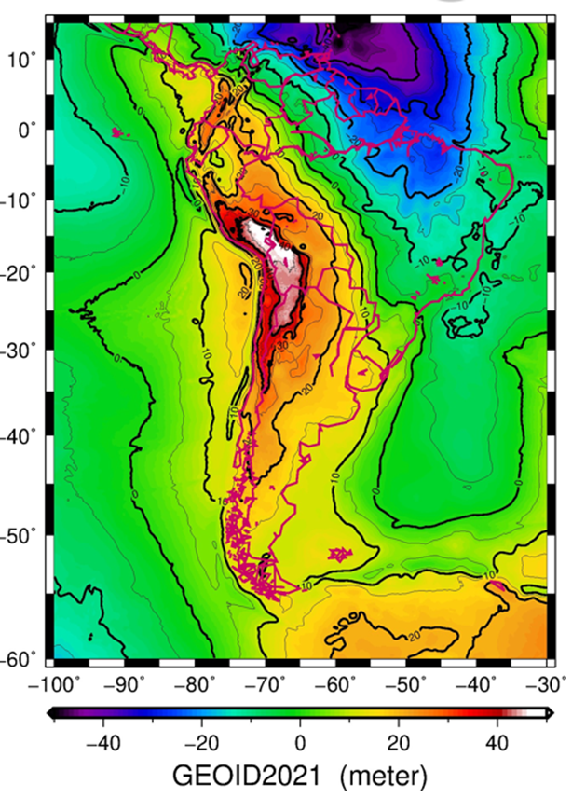
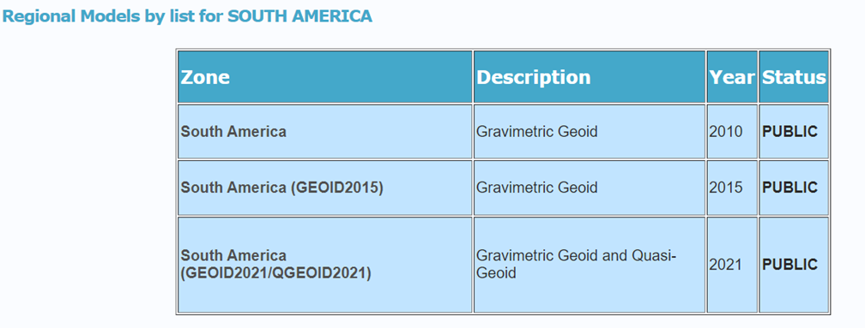
SIRGAS WG 3 - cont
IAG 2.4b
SIRGAS
SIRGAS makes geoid models available for the South American community. The models are available for download on the International Geoid Service (ISG) page of the International Geodesy Association.
Notes:
Speaker - Dan
Talking Points: The gravity data are then manipulated to produce a geoid model to serve as a vertical datum for South America (IAG 2.4b)

Slide 17
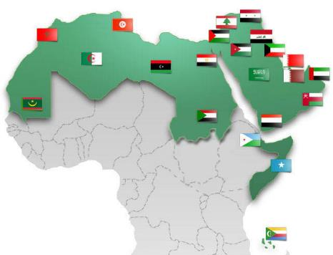
ARABREF
2014, Aug
UN-GGIM: AS established by the UN-GGIM in the fourth session in New York in August 2014.
Number of countries: 22
Arab States Members:
Algeria Bahrain Comoros Djibouti Egypt Iraq Jordan Kuwait | Lebanon Libya Mauritania Morocco Oman Palestine Qatar | Saudi Arabia Somalia Sudan Syria Tunisia United Arab Emirates Yemen

Slide 18
ARABREF
UN-GGIM-AS: Arab States: Geodetic Reference Frame Working Group (GRF-WG)
Geodetic Reference Frame Working Group: New Structure
Function:
  Provide a forum for dialogue and coordination between members of the UN-GGIM: Arab States, United Nations system, and other relevant stakeholders with a view to –
  Align with efforts to implement General Assembly Resolution 69/266 – ‘A global geodetic reference frame for sustainable development.
  Exchange information and experiences to improve national awareness and investment in geodesy.
  Collaborate with other efforts of regional committees on UN-GGIM on issues of common interest in geodesy and recognize important and relevant partners and stakeholders in successfully planning and implementing an effective geodetic network.
  Explore sharing geodetic data to contribute to the densification of Arab States regional geodetic network as well as the global geodetic reference frame and identify and address issues that inhibit such collaboration and sharing.
  Improve standards as appropriate and coordinate standards requirements.
  Plan, organize and conduct workshops and training activities on geodesy and its importance as part of capacity development.
  Develop and/or use existing communication information to educate others on the importance of geodesy and the geodetic framework for national, regional, and global benefits.
2014
(Foundation of UN-GGIM:AS)
2015
(Foundation of GRF-WG)
2016, Feb
Initiation of ARABREF concept
2016, Nov
Preliminary ARABREF Road map
2017
ARABREF Benefits and Definition
2018
Data & Analysis Centers Proposals
2019
Establish Data&Analysis Centers
2020
Alignment with SCoG
2021
Workshops and Workplan
Approved to transfer the ARABREF project from UN-GGIM:AS and register it within the Regional Reference Frame under the International Association of Geodesy (IAG)
2023
strategic objectives Extension
Approved the representatives MS of UN-GGIM-AS on the SCoG to be :
Algeria Lebanon Oman | Qatar Saudi Arabia Iraq
2024, Feb

Slide 19
ARABREF
UN-GGIM-AS: Arab States: Geodetic Reference Frame Working Group (GRF-WG)
ARABREF: Challenges
GNSS CORS data is shared only from two GRF-WG members.
Lack of Geodetic expertise in GRF-WG

Slide 20
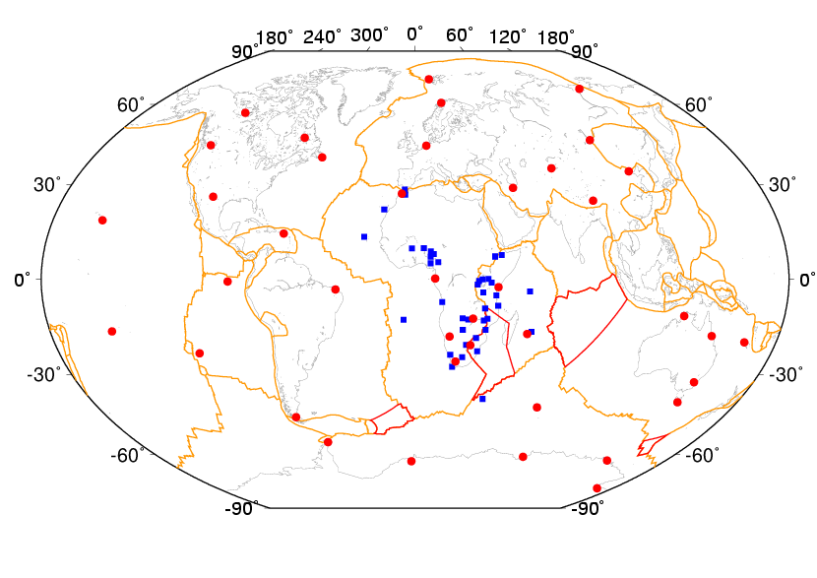
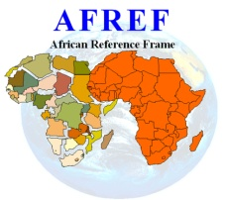
AFREF
AFREF 2014
Distribution of processed sites:
Red : ITRF/IGS sites used in the alignment to ITRF
Blue : African sites

Slide 21
AFREF
AFREF 2014
Distribution of processed sites:
Red : ITRF/IGS sites used in the alignment to ITRF
Blue : African sites

Slide 22
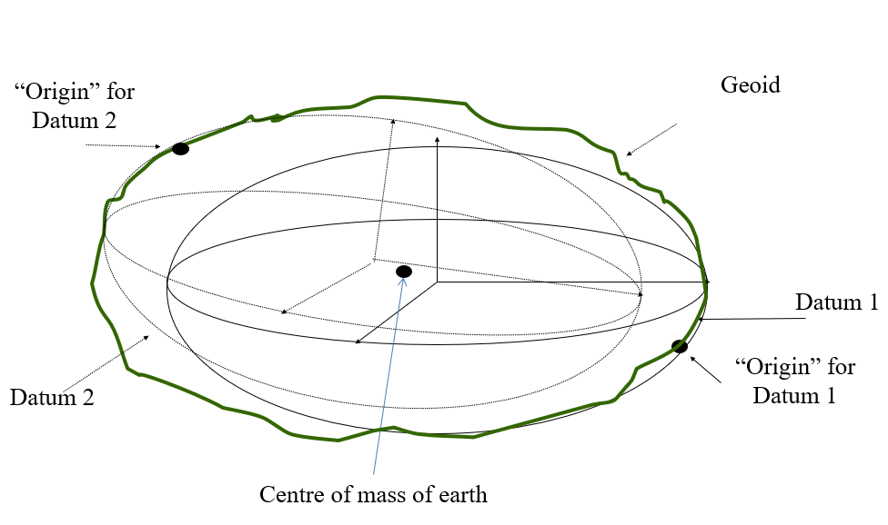

AFREF
Africa is characterised by a multitude of different non-geocentric datums, ellipsoids and different projections.
Problem is compounded by lack of authoritative and published information and publicly available information for many countries.
Records of legacy systems either destroyed or not well preserved.

Slide 23
AFREF
Economic and socio-political cost of ambiguously defined rights in land and position of infrastructure.
Unclear strategy within countries as to appropriate datums, projections and transformations to use.
Confusion and delays in cross-border projects: - transport corridors, mapping projects, conservation and environment, exploitation of mineral resources
Uncertainty and conflict regarding international borders

Slide 24

AFREF
The concept of using GNSS to unify the reference frames in Africa was first proposed at the Global Spatial Data Infrastructure (GSDI) meeting held in Cape Town, South Africa, in 2000.
Since then, many meetings and workshops have been held to address AFREF.
In 2002, AFREF was formalised as a project within UNECA .. Windhoek Declaration.
1st AFREF WG Meeting held in April 2016 during 4th High Level Forum UN-GGIM at UNECA
2nd AFREF WG Meeting held in Nov. 2017 during Africa GIS2017 at UNECA
3rd AFREF WG in in April 2018 at UNECA, Addis, where proposal was made for revised governing structure
Then , Covid…. No subsequent meetings nor progress reports.

Slide 25
AFREF
AFREF WG formed in November 2015 among other four (4) WGs for Africa.
Membership: Kenya - Chair, Botswana, Nigeria, Morocco, Gabon; RCMRD, AFRIGIS, UNECA. This has been dysfunctional since 2018.
At the 10th meeting of the Regional Committee of United Nations Global Geospatial Information Management for Africa, held in Addis Ababa (hybrid), 30 October–1 November 2024, it was resolved to reinstate an executive working group of the Regional Committee in Geodesy
Africa cannot afford to lose momentum to formalise this and confirm the TOR.

Slide 26
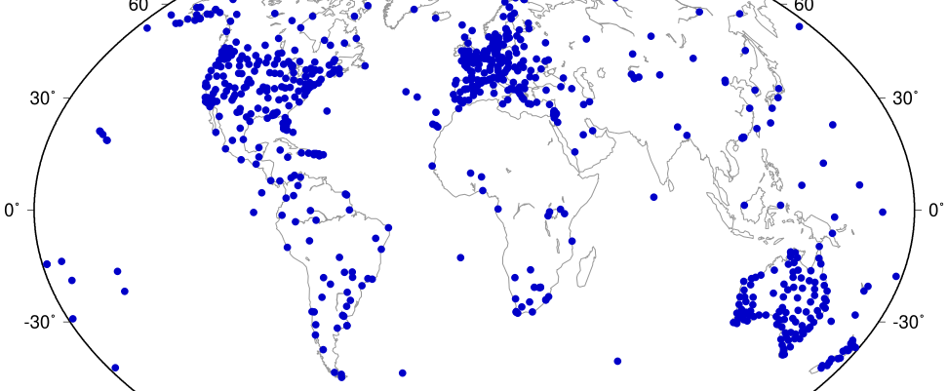
Contribution of Africa to ITRF 2020-2023
https://itrf.ign.fr/images/solutions/itrf2020-u2023/ITRF2020-u2023-NNRST-stations.png

Slide 27
AFREF
Achievements on the recommendations and actions of the previous meetings include:
Geospatial Information for Sustainable Development (GI4SD) African action plan highly commendable
Raising awareness of AFREF benefits thro’ GI4SD
Networking among institutions and practioners
AFREF Permanent Stations Guidelines published
Capacity building on AFREF done annually at RCMRD
AFREF Newsletter published and distributed quarterly by RCMRD (stalled)
Established AFREF Data Holding Centre at NGI, South Africa
South Africa leading initiative to establish GGOS Africa

Slide 28
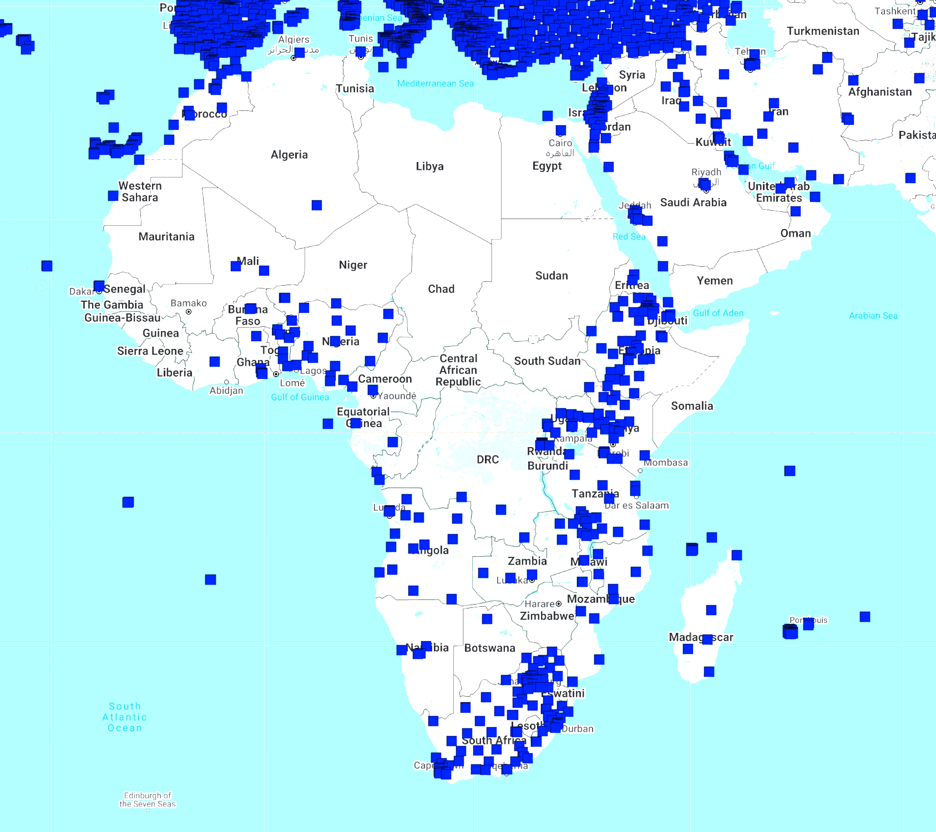
Challenges in Africa
Data Sharing – what is stopping you?
  Already today, more than 20k CORS are archived daily (in Nevada Geodetic Laboratory). Perception is that data sharing is a threat to national security.
  http://geodesy.unr.edu/NGLStationPages/gpsnetmap/GPSNetMap_MAG.html
Nevada Geodetic Laboratory

Slide 29
Template
STRONGER.
TOGETHER.

Slide 30
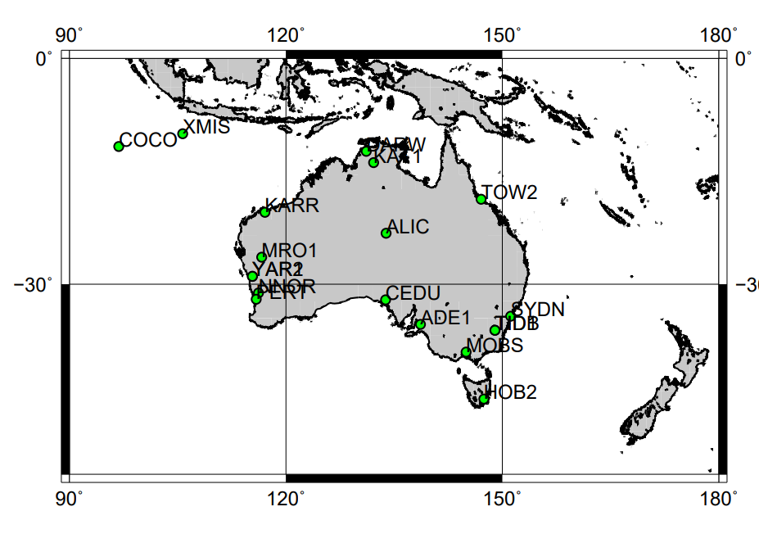
IGS20 core sites in Australia
Notes:
IGS20 core sites where data available included in APREF routine analysis
Minimum constraint of IGS20 core sites to allow the alignment solutions to IGS20 reference frame

Slide 31
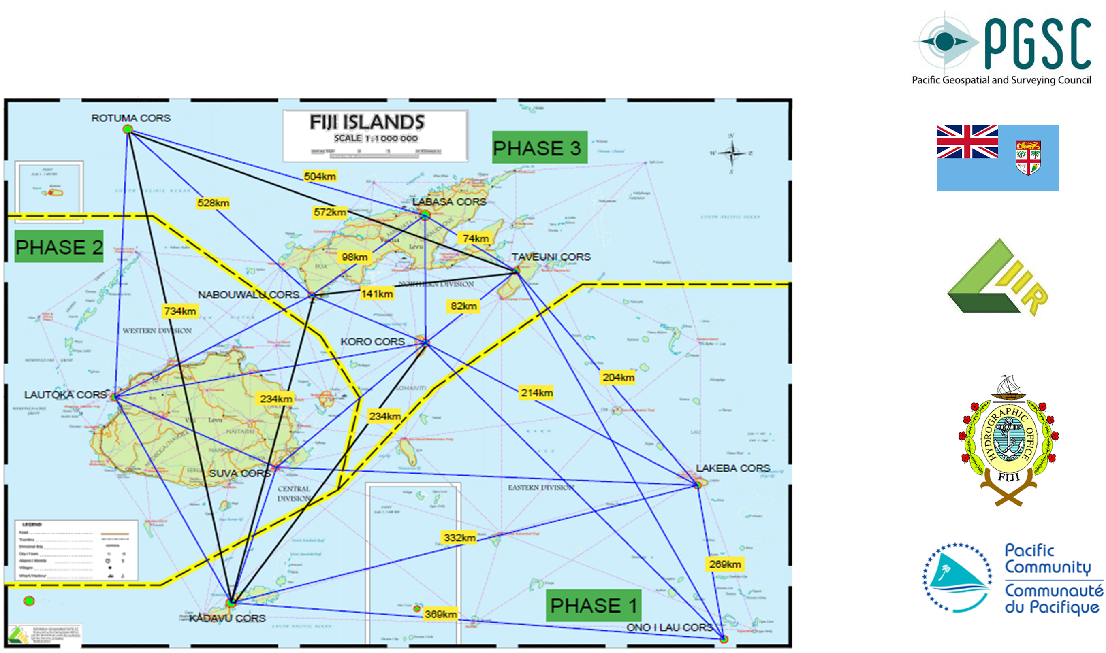
Fiji GNSS Geodetic Survey Network
Notes:
IGS20 core sites where data available included in APREF routine analysis
Minimum constraint of IGS20 core sites to allow the alignment solutions to IGS20 reference frame

Slide 32
Pacific use of APREF
Sea level rise monitoring
  Long-term aid program of joining land and sea data via APREF CORS
Definition of legal maritime boundaries recognised by the UN
Basis of multi-million dollar
  construction and infrastructure projects
  climate change mitigation projects
  disaster risk reduction projects
Notes:
IGS20 core sites where data available included in APREF routine analysis
Minimum constraint of IGS20 core sites to allow the alignment solutions to IGS20 reference frame

Slide 33















Collaboration
Notes:
Most importantly, PGSC members acknowledges its partners for good partnership and great collaborative efforts for working together.

